Slide 1

NYSE Data
Sector Comparison & Company Forecasting.
Question: How does the industries within the financial sector compare to each other.

Slide 2
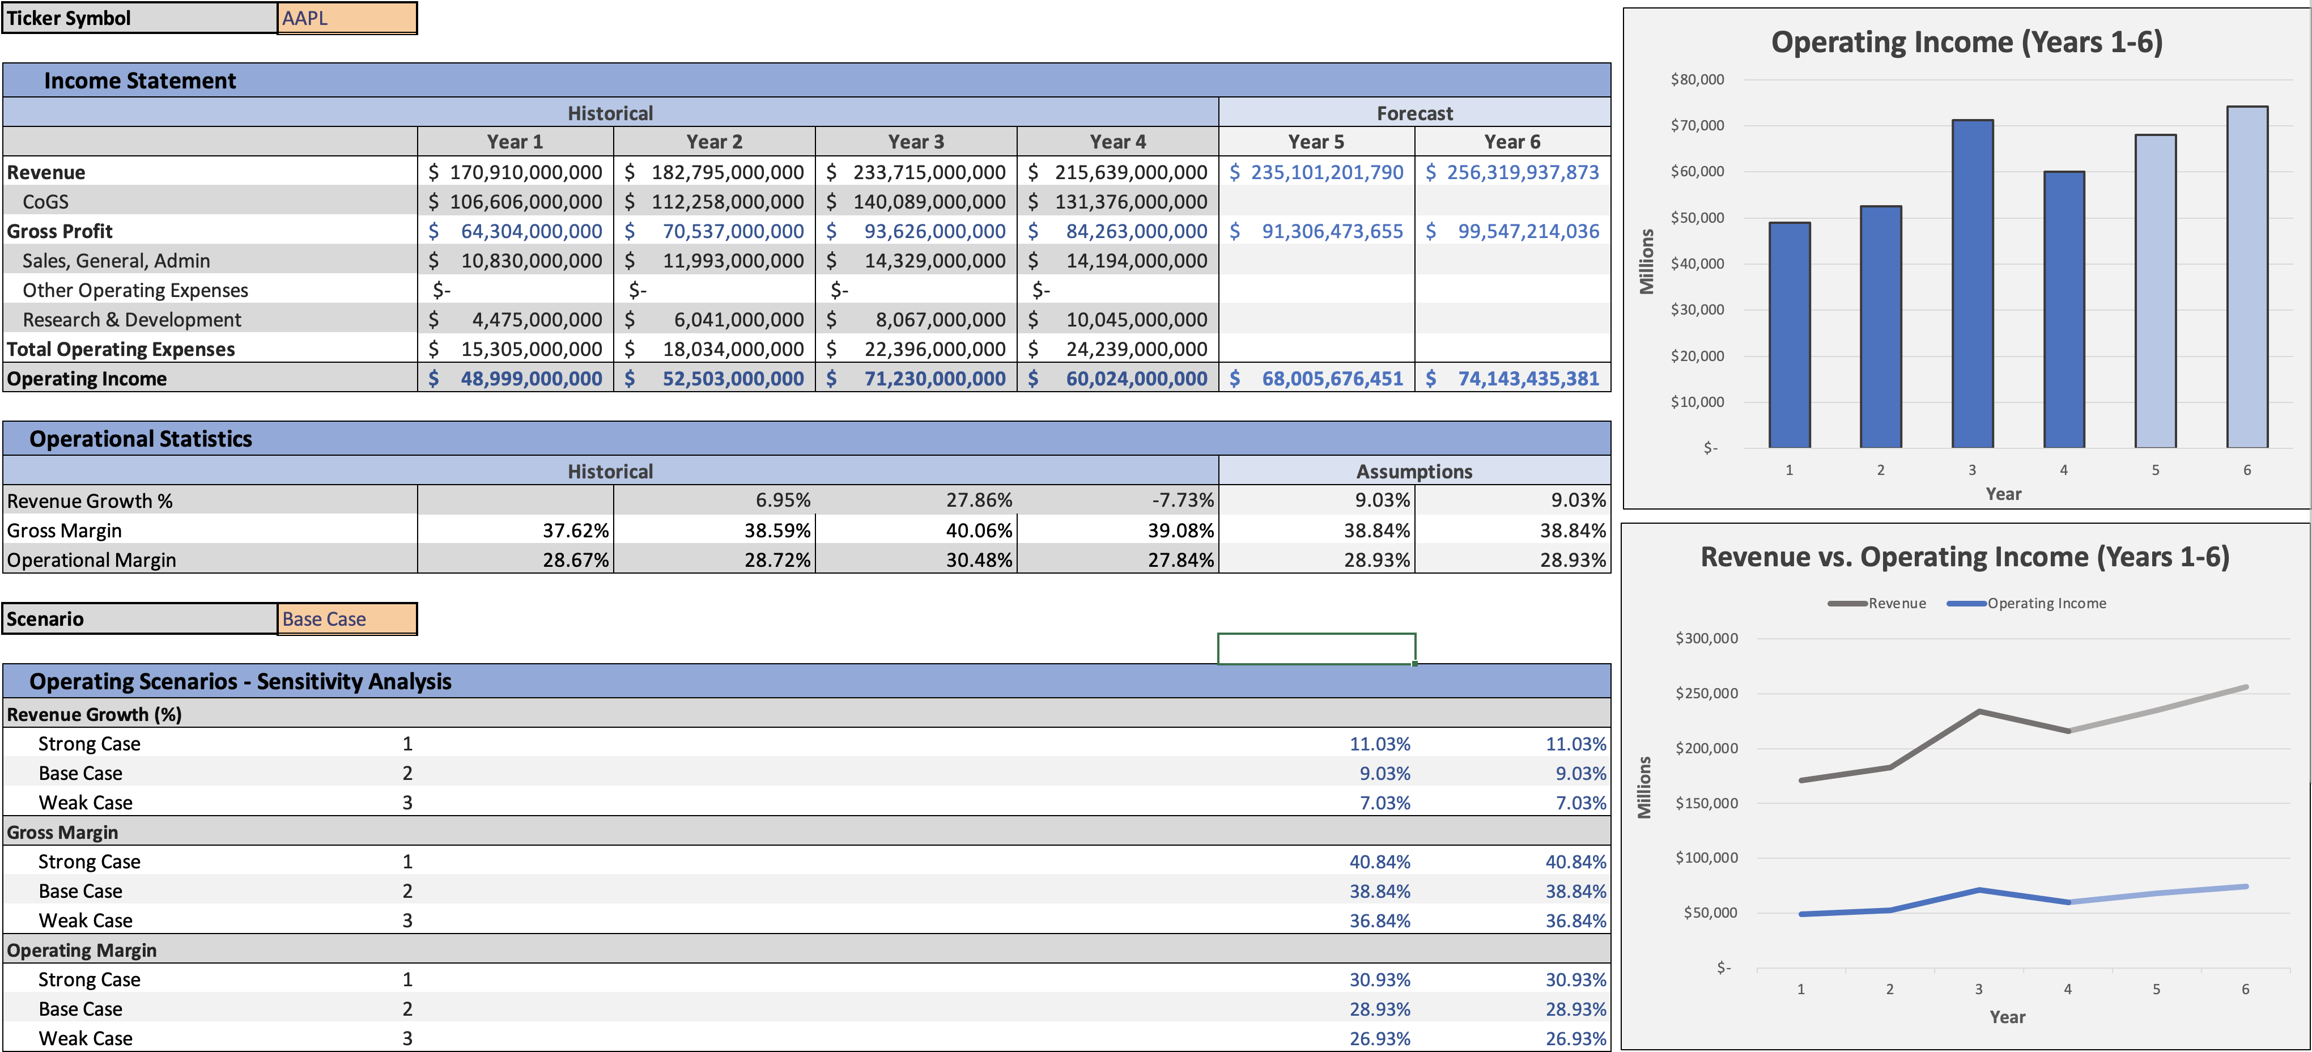
AAPL Forecast Scenario

Slide 3
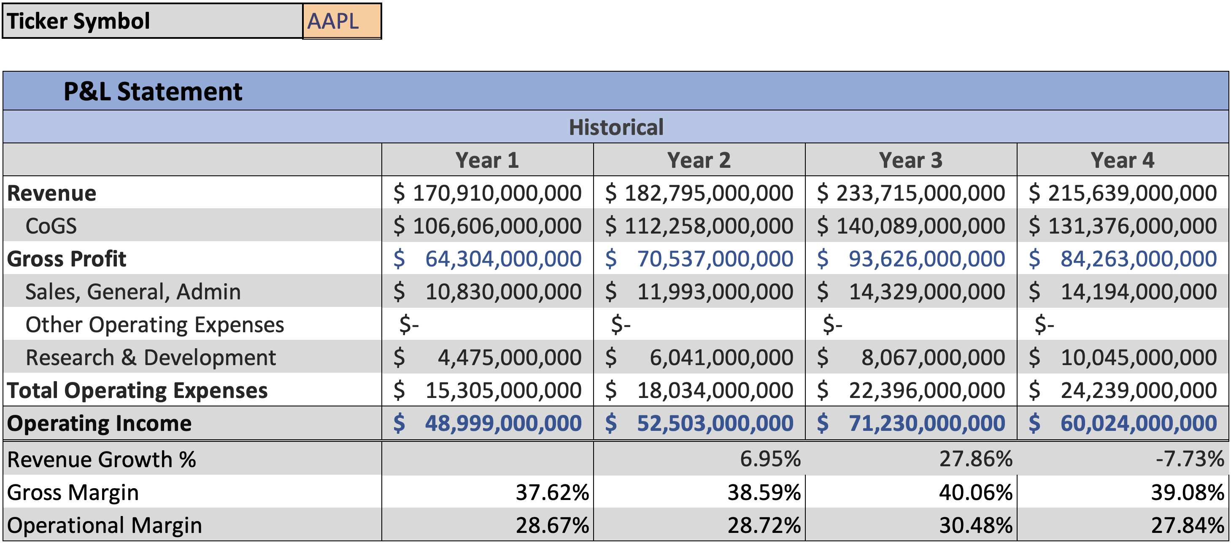
AAPL P&L Statement Dashboard

Slide 4
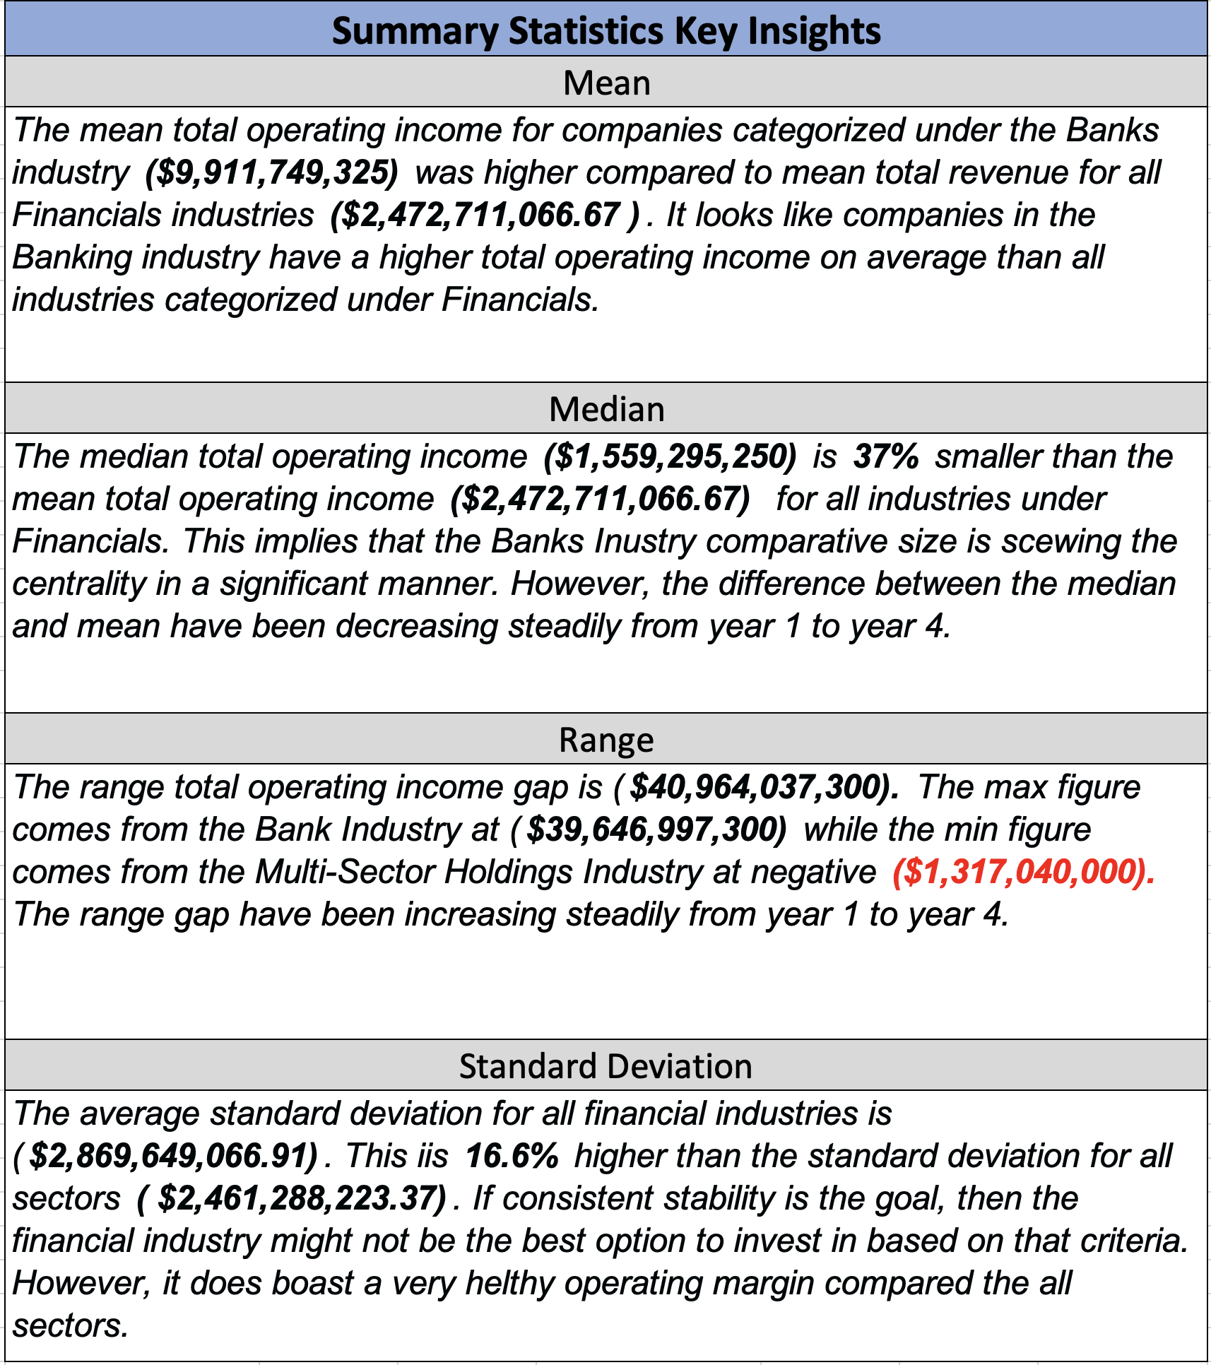
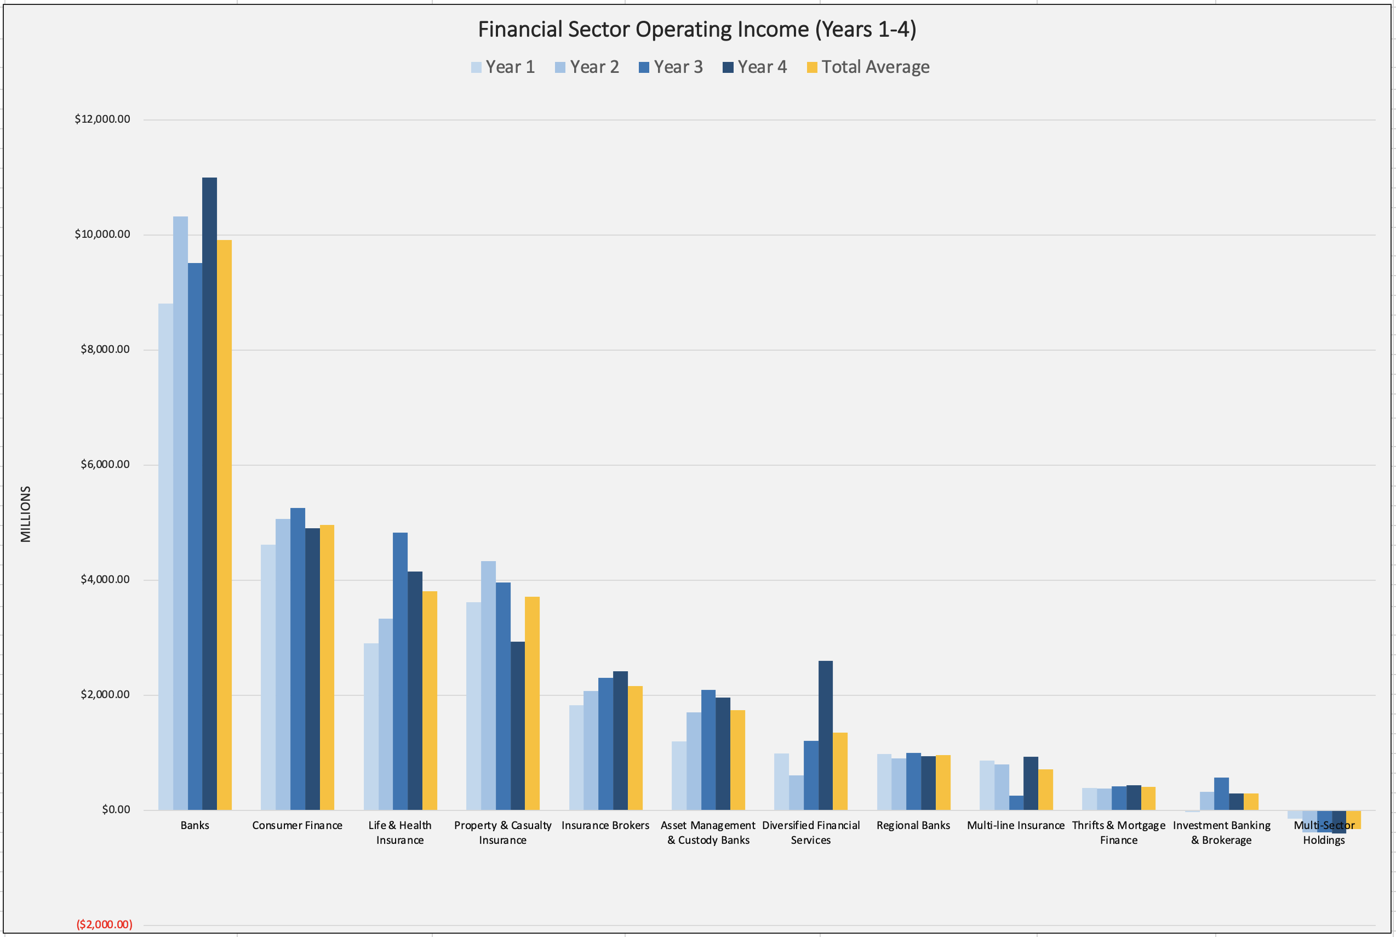
Financials Summary Statistics & Fey Insights
*For further data insights, refer to the excel document.

Slide 5
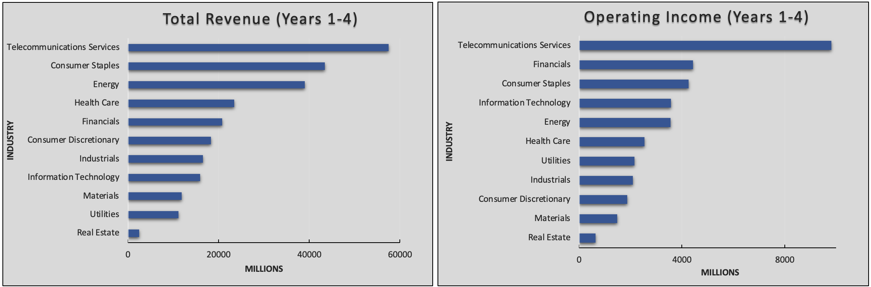
Sector Comparison Revenue & Income

Slide 6
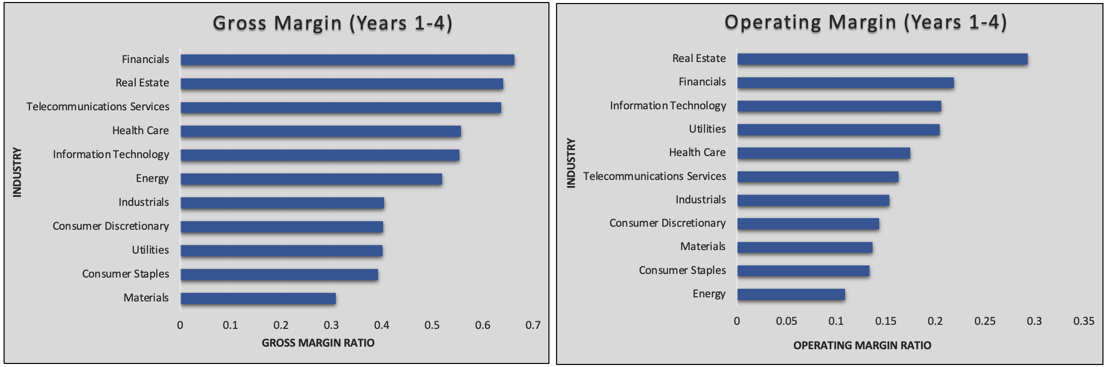
Sector Comparison Gross Margin & Operating Margin

Slide 7
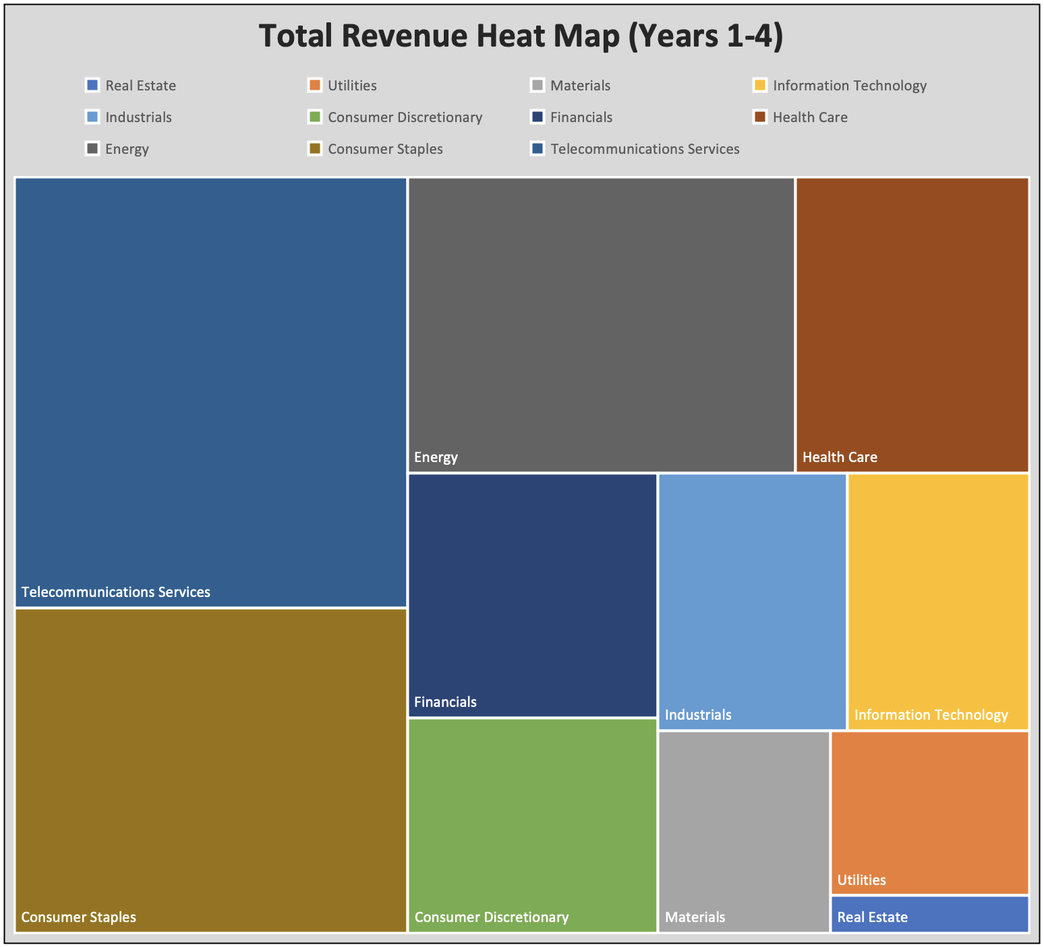
Sector Comparison Total Revenue

